Slide 1
Sociology
Sociology’s Perspective of Health Inequity and How it Resulted in Social Murder

Slide 2
Table of Contents
01
02
03
04
05
06
07
About the Course
Health Inequity and Social Death
Assignment #1:
Harmful Living Conditions
Introduction and Course Overview
Mindmap
Lesson
Lesson
Assignment #2:
Assignment #3:
Final Test
A short quiz on identifying harmful living conditions
Students collaborate to make test questions
Show your understanding of this course

Slide 3
01
About the Course
Introduction and Course Overview

Slide 4
Introduction: Your Instructors
Kyla Pattie
Jialong Li
Yixuan Zhang
Alison Neale
I am a fourth year sociology student. I will be continuing my studies to attend medical school and specialize in Dermatology.
I am a 2nd year Uvic student interested in Sociology
I am a junior at the University of Victoria, I like learning and discussing about sociology.
I am a 4th year sociology student interested in human behaviour and surveillance studies.

Slide 5
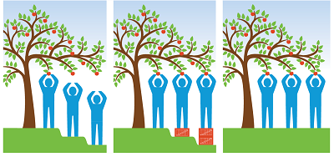
Our Learning Theory
This course will be based on the following theories.
1.Cognitivist Theory: Students will store sociological theories in their knowledge structure by guiding their perception of health inequity and social murder. Ultimately, students will actively consider the underlying factors of health inequity and social murder and the link between them and social justice.
2. Constructivism Theory: Enhancing the learner's initiative through exciting teaching and learning, understanding college-level students' prior knowledge experiences, and designing sociological learning interactions based on them.

Slide 6

Course Overview
This class will take between 1-2 hours to complete
Overview of Learning Theory, and Learning Design
Who this course is intended for
The significance of this topic and background
Definitions and Examples of Health Inequity and Social Murder
3 Interactive Activities (peer quiz, mind map, and group activity)

Slide 7
Course Overview Continued...
In this introductory university course, we will demonstrate the sociology of health inequity and social murder.
Our instructional design process will focus on selecting media and information resources and the planning of the teaching process.
Our objectives are as follows：
To clarify the depth of health inequity and social murder, students learn by analyzing the learning content and learners.
To analyze teaching needs and determine practical and realistic teaching objectives based on social conditions, student characteristics, and subject-specific learning content.
Students will gain an initial understanding of health inequity and social murder theory through this course. In addition, students will develop critical thinking and the ability to use sociological theory to analyze problems.

Slide 8
Our Learning Design
Our rationale for choosing health inequity and how it results in social murder is based on the seriousness of the issue. We all signed up for this group out of self-interest in the topic of sociology. We acknowledge the social injustice issues around the world in health and want to educate others on this issue and hopefully expand others' interest in the subject matter.
With that being said, we will implement inquiry-based learning as our learning design in this course. We will do this by shifting the traditional teacher teaches and the student listens role to student to student discussions. This allows students to explore material, share ideas and ask questions in a more personal and interactive way with other learners in the same position. Additionally, strengthening knowledge through exploration and discussion generates useful feedback and reassures the student that they are understanding the material. Inquiry-based learning is an effective course of action for our course because we learn from our experiences and with this method, students can effectively retain information, and expand their comprehension of the course.

Slide 9
Student Demographic
This course is a 100 level introductory university course on the sociology of health inequity and social murder.
This course is for all students who attend post-secondary school, are 17 years old and above, and have access to a computer.
Students who have an interest in health education and want to learn more about how sociology influences health will find this course beneficial.

Slide 10
Learning Objectives
01
02
03
04
By the end of the course, students will be able to:
Create
Identify
a mind map of modern social influences on health.
harmful living conditions that the English working-class encountered with a short quiz.
Construct
Demonstrate
formative test questions on health inequities and social murder by collaborating with other students in the class.
your understanding of health inequities and social murder with a student made test.

Slide 11
Methods of Instruction
Powerpoint Lecture Slides
In order to deliver an effective course to a wide range of students, we will be using methods and materials that favor all types of learning:
Visual learning (graphics and simple text)
YouTube Videos
Auditory and visual learning
Assigned Readings
Visual learning
(complex and simple text)
Group Discussions
Auditory and verbal learning
Written Tests
Reading and writing learning

Slide 12
Inclusion
An inclusive classroom provides various learning and assessment opportunities, and a variety of voices. Having these factors encourages every learner that their learning ability and voice is significant and necessary for a successful learning environment.
It is also important to keep in mind that there are many different types of learners and we will also be inclusive to:
English Language Learner
Color Blindness

Slide 13
Inclusion of color blindness students
As teachers, we need to know in advance which colors have blind spots, and how many kinds of color blindness exists. We will do this with the help of color-blind images.
When writing on the blackboard, use white chalk as much as possible to enhance the contrast between the words and the blackboard.
Similarly, write on the whiteboard with a black marker.
Use as much white paper as possible.
Avoid relying on colored labels or text. Instead, an adjective that describes color.
If colors must be used, assign a trusted friend of the color-blind student to help them.
Watch your class for students who are embarrassed to say they have color recognition deficits. Creating an inclusive language and classroom atmosphere enhances their confidence in learning.

Slide 14
Inclusion of ELL
Start by assessing ELLs background to determine the degree of aptitude.
Show the students our teaching objectives and the tasks they should accomplish.
Teach slowly and clearly, and allow ELL plenty of time to think and react.
Use multiple non-verbal AIDS. Good, introducing visual, auditory, and body language to help ELL understand the lecture.
Provide timely answers to ELLs' questions and follow up regularly to check their understanding.

Slide 15
Assessment
Formative
Summative
Assignment #1: Mind Map
20%
Assignment #2: Short Quiz
20%
Assignment #3: Quality of Questions & Participation
15%
Final Test:
45%
Grade Scale
92%-100% A
85%-91% A-
78%-84% B
73%-77% B-
69%-72% C
60%-68% C-
50%-59% I
0%-49% F

Slide 16
02
Health Inequity and Social Murder
Lesson

Slide 17
2.3 Million
Canadian adults perceive their health as fair or poor.

Slide 18
Health Inequity:
The systematic difference of health amongst distinct groups of people (Marmot et al, 2008, p.1661). These differences between countries are caused “by the unequal distribution of power, income, goods, and services, globally and nationally” (Marmot et al, 2008, p. 1661).
For example, poor living conditions, contaminated waters, no access to health care and a lack of education. These health inequities can worsen based on the individuals generated income, disability, race, gender, geographic location, and sexual orientation (p. Marmot et al, 2008, 1667).
Social Murder:
Placing lower class workers in “conditions in which they can neither retain health nor live long; that it undermines the vital force of these worker’s gradually, little by little, and so hurries them to the grave before their time” (Engles, 2006, p. 400).
For example, not being cared by and neglected by your government leads groups of people to experience mental and physcial strain resulting in social murder.
The era we will be focusing on is 1844 England. Although these conditions of the working class happened over a hundred years ago, these health inequity issues still occur today. Governments neglect individuals’ basic needs by allowing them to live in these horrifying conditions.

Slide 19
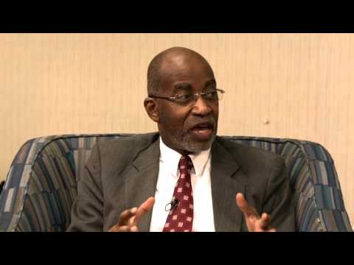
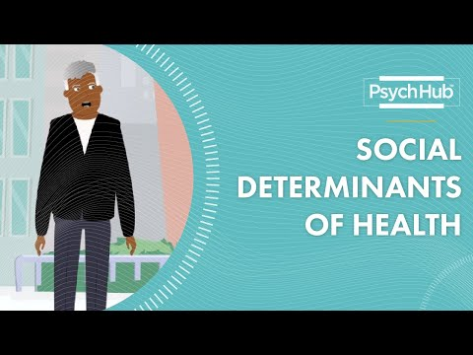
Watch these YouTube Videos
What is health inequity and why does it matter?
4 minutes
Social Determinants of Health
4 minutes

Slide 20
03
Assignment #1: 20%
Create a mind map using recall memory to identify modern social influences on health. You can type it or write it out! Brainstorm ideas with your classmates!
This is worth 20% of your final grade. You have 25 minutes to complete this assignment.
Have fun!

Slide 21
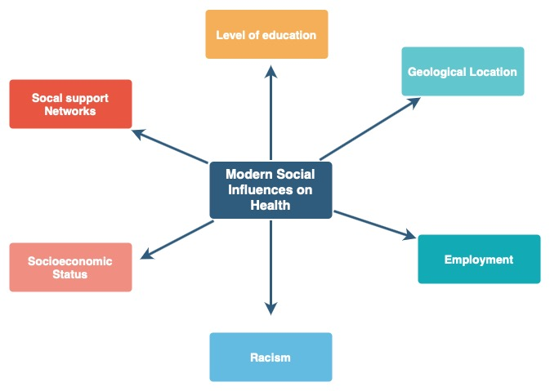
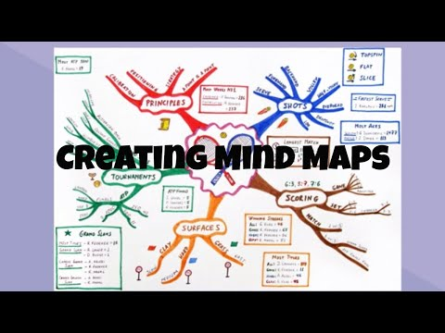
Mind Map Example
Use this image as a reference and watch this 2 minute YouTube video! Have fun!

Slide 22
04
Harmful Living Conditions
Lesson

Slide 23

We have the right to safe drinking water

Slide 24
Harmful Living Conditions
Assigned Readings
The Great Towns by Frederick Engels (first 3 pages)
Health Problems by Dr Paul Wilkinson
Poor Working Conditions by Sarah Wright
The conditions of the working class in England in 1844.
Health problems associated with poor housing and home conditions, inadequate water supplies, flooding, poor sanitation and water pollution.
Job characteristics are more detrimental to the health of females and older workers than to men or younger workers.

Slide 25
Main Points: The Great Towns by Frederick Engels
In England, the Manchester bourgeois were aware of the harmful living and work conditions that prevented the English working class from living a happy and healthy life course but did nothing to improve these conditions. The workers’ cottages were old, dirty ,and small. The streets were uneven, fallen into rust and in part without drains or payment. The atmosphere was poisoned by the effluvia from these, and laden and darkened by the smoke of a dozen tall factory chimneys (Engles, 2006, p. 397). Individuals were breathing in constant toxins that were harmful to their bodies. Breathing in all these toxins, increased the rate at which people were ill. Another factor was having a dozen individuals living in a single room (Engles, 2006, 401). Being closely compacted made contamination spread even quicker. One of the key remedies, when you’re sick, is sleeping and resting your body. Those in England at the time were deprived of rest, and “worked every day to the point of complete exhaustion of their mental and physical energies…” (Engles, 2006, 401). Due to workers being neglected, the lower class was often sick. Being worked to the point of exhaustion and living in compacted environments increased the influenza rate in 1844 England.

Slide 26
Additionally...
Where they lived, was an IRK river. The water in the river also affected the working class living there. All the drainage and garbage from the nearby tannery and gas plant would flow into the IRK river. The cofferdams around the river are surrounded by dirty mucus and rotten garbage. As a result, the living environment of the people living there has become worse, surrounded by the stench and dirty water quality (Engles, 2006, p. 391). People living near the IRK river have access to water from the dirty IRK river, and water pipes and pumps can only be used indecent parts of the city. In such a living environment every day, they have no opportunity to meet their most basic living needs. when the most basic living resources are not guaranteed, they also have no ability and power to clean and maintain their living environment (Engles, 2006, p. 392). Ultimately, a huge part of our health is determined by working conditions so if this need is not met, our physical, mental, and social well-being plummets making social murder inevitable.

Slide 27
Modern Solutions to Improve Improve Working and Living Conditions
01
02
03
Build Local Capacity
It is not enough to identify problems; suppliers must be able to address them.
Measure work environment performance
Indicators are needed to measure performance, identify problems, and eliminate root causes.
Show appreciation and support
Make sure all employees know they are doing a good job and get recognition for it.

Slide 28
05
Assignment #2: 20%
Identify harmful living and working conditions that the English working-class encountered with a short quiz.
This quiz contains 10 multiple choice questions worth 2 marks each, for a total of 20 marks. It is worth 20% of your final grade. Questions will be based on the assigned readings. This is a closed book quiz with no time limit.
Please click the link below to begin :) Good luck!
Start the Quiz
A short quiz on Google Forms on identifying harmful living conditions

Slide 29
06
Assignment #3: 15%
Partner up with 1 other student and construct 1 multiple choice question on health inequities, and 1 multiple choice question on social murder.
The quality of your questions and your participation is worth 15% of your final grade.
You have 10 minutes to formulate your questions.
Have fun!

Slide 30
07
Final Test: 45%
Demonstrate your understanding of health inequity and social murder with student made test questions.
This is worth 45% of your final grade. This is a closed book test with no time limit.
Good Luck!

Slide 31
Conclusions
How we think as individuals, and how we act in society not only affects our own health, but the world’s health, function and culture.
At the end of the day, it is up to us to decide how society will be driven, consist of and leave behind for the next generation.

Slide 32
Alternative Resources
Click Here
.
Click Here
.
Click Here
.
Click Here
.
Click Here
.

Slide 33
Thanks!
Do you have any questions? Ask your instructors!
alisonneale@uvic.ca
Jialongli@uvic.ca
kylapattie@uvic.ca
yixuanz@uvic.ca
You are now a sociology thinker!
!
Please keep this slide for attribution.

Slide 34
References
Archives+. (2020, August 8). A Pandemic from the Past: Manchester and Cholera 1832. Archives +. Retrieved October 9, 2020, from https://manchesterarchiveplus. wordpress.com/2020/08/08/a-pandemic-from-the-past-manchester-and-cholera-1832/
Engels, F. (2006). Selections from The Condition of the Working Class in England in 1844. Organization & Environment, 19(3), 389-402.
Marmot, M., Friel, S., Bell, R., Houweling, T. A. J., &amp; Taylor, S. (2008). Closing the gap in a generation: health equity through action on the social determinants of health. The Lancet, 372(9650), 1661–1669. https://doi.org/https://doi.org/10.1016/S0140-6736(08)61690-6.
University of Texas Arlington Libraries. (2021, September 14). Sociology [Photograph]. https://libguides.uta.edu/sociology#gsc.tab=0

